Slide 1
AirBnb Recommendation System
Group 7
Wong Xin Pei
Candy Lim
Tan Jun Xian

Slide 2
AGENDA
DS/ML Tools
03
Objective
01
Exploratory Data Analysis
04
Data Preparation
02
TF-IDF, Cosine-Similarity, K-NN, Doc2Vec, PCA, Tensorboard
Practical motivation to the “interesting problem”
What to accomplish?
Visualisation of the results Tensorboard, GoogleMaps, Calplot
Conclusion
05
Exploration & Cleansing
Objectives met?
Interesting outcomes

Slide 3
OBJECTIVE
01
Practical Motivation to the “Interesting Problem”
What to accomplish?

Slide 4
DATASET
AirBnb Open Data from Seattle
Default problem: Classification using natural language processing

Slide 5
OBJECTIVE
ID | Name | Description | Availability
200 | Awesome Apartment |  | 80%
210 | Luxury Location |  | 90%
250 | Cozy Downtown |  | 100%
I want a big and cozy room and a nice house. It must be near the downtown area for easy access. It must also have an amazing view of the city.
User Input
Recommendation
To recommend, we need to
Find similarity between user’s input and the listing descriptions

Slide 6
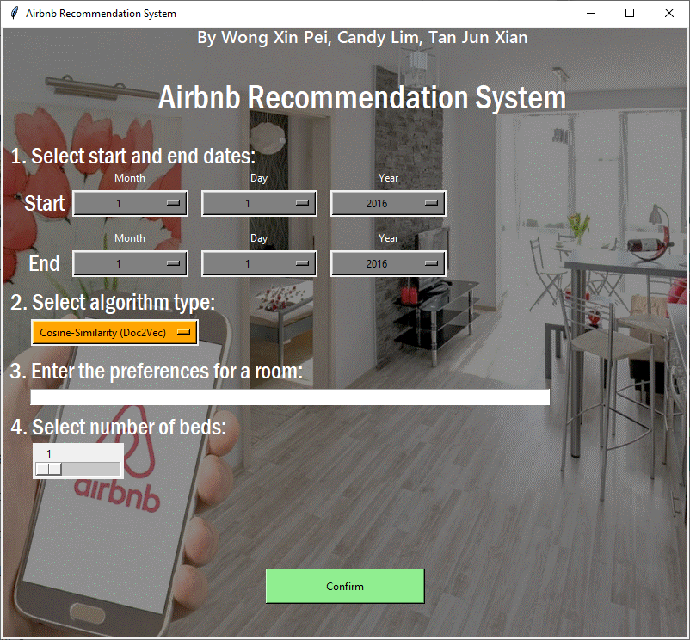
OBJECTIVE
Intelligence Make a GUI for user to select the model type to recommend the listings
Utilisation Do we need to use all the excel files?
Listings.csv
Reviews.csv
Calendar.csv
Practical solution User chooses dates to stay and no. of beds
Flexibility User uses text to specify the wants and needs

Slide 7
DATA PREPARATION
02
Exploration and Cleansing

Slide 8
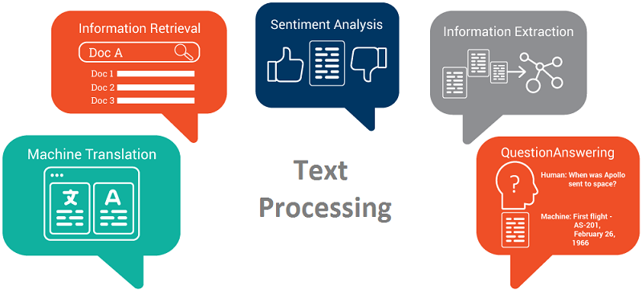
DATA EXPLORATION
Notes:
https://towardsdatascience.com/machine-learning-text-processing-1d5a2d638958

Slide 9
DATA EXPLORATION AND CLEANSING
Our Ideal Dataset
Based on the description from Listings.csv to determine the results of the model
Based on the dates available for staying from Calendar.csv
Capitalise the column names
ID | Name | URL | Location
384797 | Best Coffee in Seattle | airbnb.com/ rooms/384797 | (47.62, -122.32)
6977095 | Clean City House | airbnb.com/ rooms/6977095 | (47.66,-122.34)
438400 | Spacious West Cottage | airbnb.com/ rooms/438400 | (47.56, -122.37)
Score
0.98
0.75
0.21
Reviews | Availability (%)
Positive | 87.67
Mostly Positive | 89.86
Positive | 75.63
Listings.csv
Based on the comments given by users from Reviews.csv to determine the polarity
Merging of Latitude and Longitude columns in Listings.csv

Slide 10
DATA CLEANSING
Cleansing the Description for analysis later
Unstructured Description
Cleansed Description
New modern house built in 2013. Spectacular sunset/water views and light, rooftop deck and lounge area, hot tub, 5 bedrooms, gourmet kitchen.
new modern house built in 2013 spectacular sunsetwater views and light rooftop deck and lounge area hot tub 5 bedrooms gourmet kitchen
Activated
pandas package
re package
Successfully
Lowercased all the words
Removed all non-text data (eg: punctuations, special character)
Removed stopwords*
*Only for user-input

Slide 11
DATA CLEANSING
Merging of Latitude and Longitude columns
How do we merge together?
Oh no, cannot recognise which is latitude, and longitude
Yeah! Can visualize on Google Maps
Latitude | Longitude
47.62, | -122.32
47.66 | -122.34
47.56 | -122.37
Location
(47.62, -122.32)
(47.66,-122.34)
(47.56, -122.37)
Location
(47.62, -122.32)
(47.66,-122.34)
(47.56, -122.37)
Both columns are numeric
Concatenate ‘(‘ + latitude + ‘,’ + ‘longitude’ + ‘)’
The column is a string
Convert the column from string to tuple

Slide 12
DATA CLEANSING
Getting the availability percentage of each listing
listing_id | date | available | price
240132 | 2016-01-01 | t | $85.00
240132 | 2016-01-02 | t | $85.00
240132 | 2016-01-03 | f
listing_id | date | available
240132 | 2016-01-01 | 1
240132 | 2016-01-02 | 1
240132 | 2016-01-03 | 0
listing_id | Availability (%)
240132 | 0.84
353362 | 0.63
240132
Converted t/f to 1/0
Dropped the price column
Get the mean of the available column
Round off the column in 2 decimal place

Slide 13
DATA CLEANSING
Getting the polarity of each listing
listings_id | comments
7202016 | Cute and cozy place. Perfect location to every
7202016 | Kelly has a great room in a very central locat...
7202016 | Very spacious apartment, and in a great neighb.
Cleanse the dataset - same method as Description in Listings.csv
Import TextBlob library to calculate the sentiment score
listings_id | polarity
7202016 | 0.8389732
7202016 | 0.7829385
7202016 | -0.2332525
listings_id | polarity
7202016 | Positive
8920932 | Mostly Positive
9023097 | Positive
Get the mean of the polarity column – same method as availability percentage
Convert numeric values into ordinal values
Notes:
Reviews score rating
Reviews score accuracy
Reviews score location
TextBlob library This is rule-based

Slide 14
DS/ML TOOLS
03
TF-IDF
Cosine-Similarity
K-NN
Doc2Vec,
PCA
Tensorboard

Slide 15
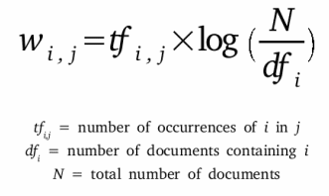
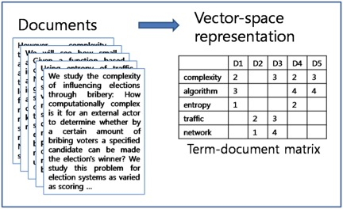
TF-IDF
Term = word
Term Frequency – Inverse Document Frequency
Number of times a term (t) appeared in a doc (d)
Total number of docs (d)
*
Total number of docs (n)
Number of documents with the term (t) + 1
Log
Determine how important the word is, in the description
Process of giving a word a numeric value (w)
Vectorize the words/descriptions

Slide 16
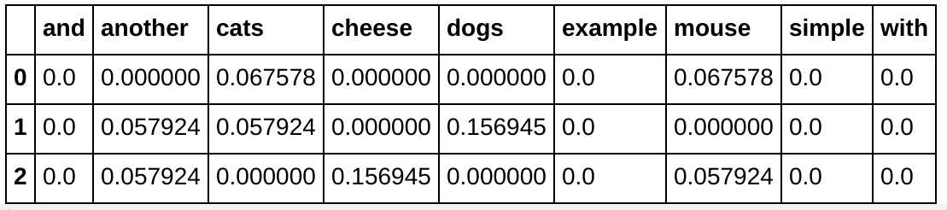
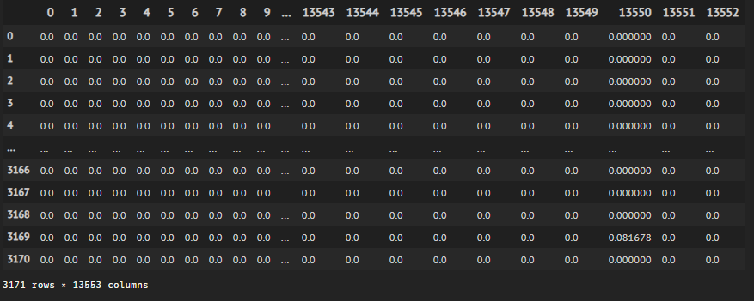
Example
Words
Documents
Words
Descriptions of each listing

Slide 17
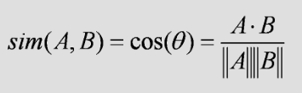
COSINE-SIMILARITY
Determine how similar words/documents are regardless of magnitude
Where
A = User’s Input
B = Description
A
A
A
A
B
B
Since angle is small,
Similarity value will be high
Exactly same,
Similarity value will be 1
Similarity value will be 0

Slide 18
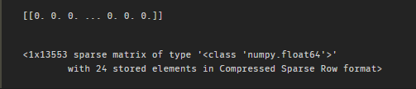
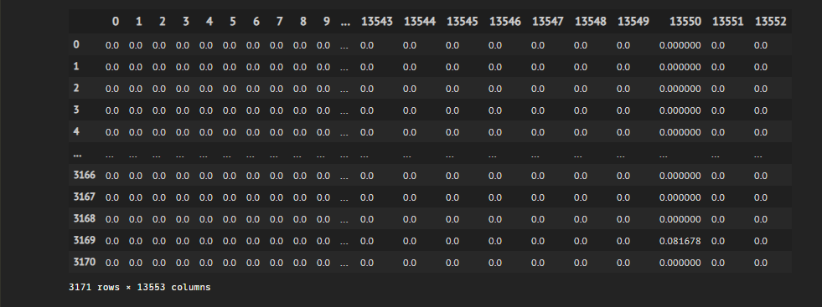
COSINE-SIMILARITY
I want a big and cozy room and a nice house. It must be near the downtown area for easy access. It must also have an amazing view of the city.
Calculate Cosine Similarity of User vs Each of every listing
User Input

Slide 19
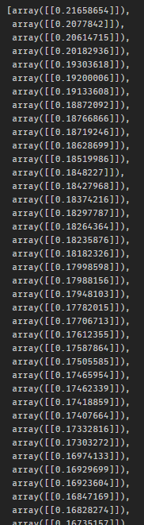
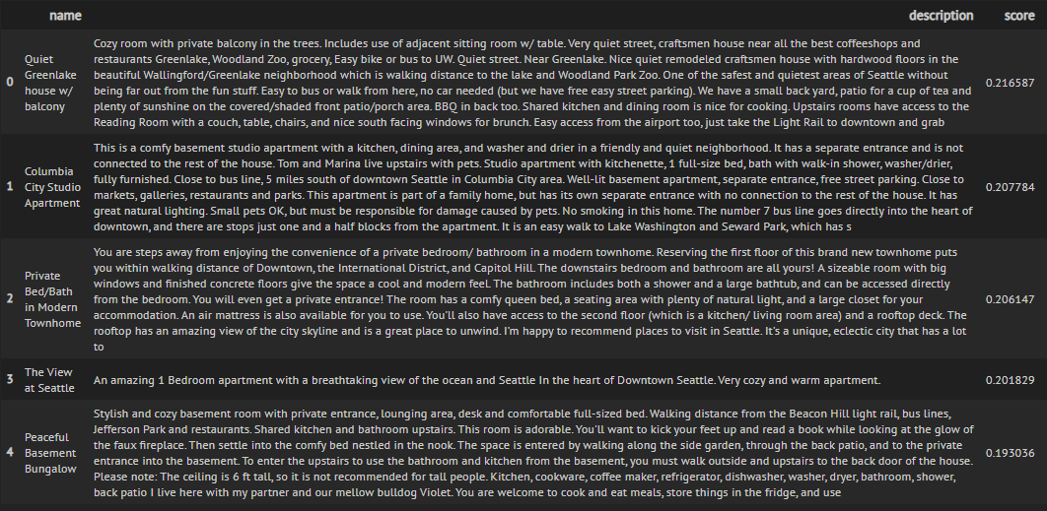
COSINE-SIMILARITY
I want a big and cozy room and a nice house. It must be near the downtown area for easy access. It must also have an amazing view of the city.
Cosine Similarity Values
User Input

Slide 20
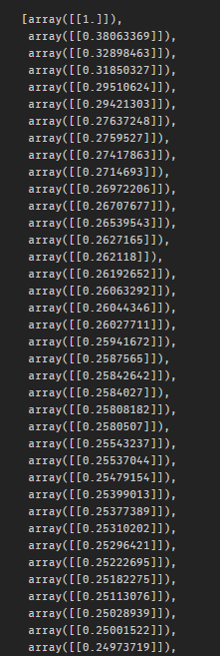
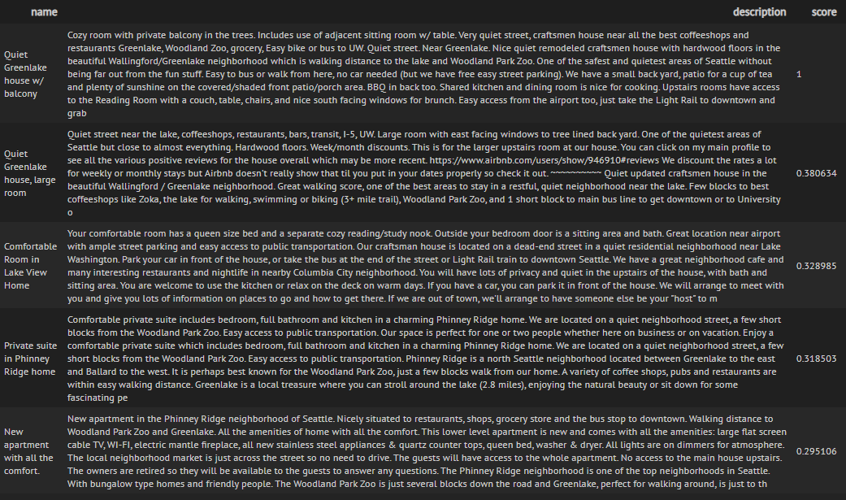
COSINE-SIMILARITY
Cozy room with private balcony in the trees. Includes use of adjacent sitting room w/ table. Very quiet street, craftsmen house near all the best coffeeshops and restaurants Greenlake, Woodland Zoo, grocery, Easy bike or bus to UW. Quiet street. Near Greenlake. Nice quiet remodeled craftsmen house with hardwood floors in the beautiful Wallingford/Greenlake neighborhood which is walking distance to the lake and Woodland Park Zoo. One of the safest and quietest areas of Seattle without being far out from the fun stuff. Easy to bus or walk from here, no car needed (but we have free easy street parking). We have a small back yard, patio for a cup of tea and plenty of sunshine on the covered/shaded front patio/porch area. BBQ in back too. Shared kitchen and dining room is nice for cooking. Upstairs rooms have access to the Reading Room with a couch, table, chairs, and nice south facing windows for brunch. Easy access from the airport too, just take the Light Rail to downtown and grab
Cosine Similarity Values
User Input

Slide 21
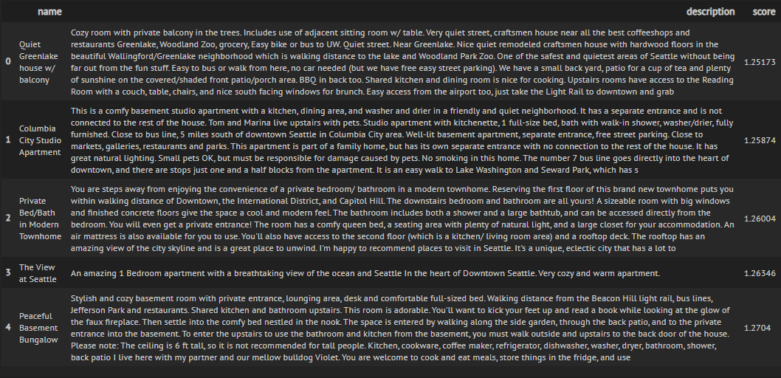
K-NN
User’s Input
K-Nearest Neighbours
Listings are in vector form
Points on graph
Find Nearest neighbours of “User-Input point” -> Using Euclidean distance

Slide 22
Doc2Vec (PV-DM)
Word2Vec (Skip-Gram, Window-Size=2)
Simple 2 layer neural network model
Group similar words/doc together
Output
Target
Input
Hidden
0.1
0
Doc1
Doc2
Doc3
[0.34, 0.28, …]
[0.32, 0.21, …]
[0.1, 0.02, , …]
1
w1
want
I
0
0.8
1
w2
0
0.1
0
0
w3
Doc1
0
0
Doc1
Unique Tag
Doc3

Slide 23
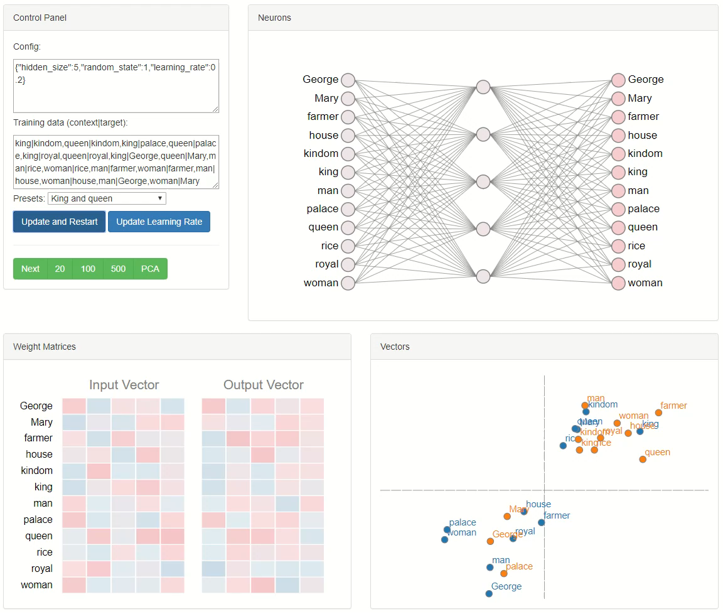
Input Training Pairs
Word2Vec
1 Unique Word = 1 Vector
Doc2Vec
1 Doc = 1 Vector

Slide 24
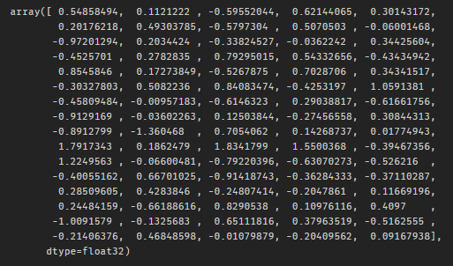
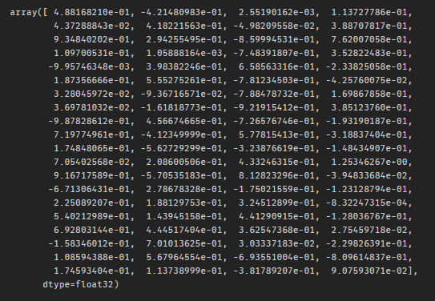
Doc2Vec (PV-DM)
Private bedroom with amazing views of DT. Seattle in the heart of downtown. When I am home, I'll sleep on the couch in the living room. The unit is in a very nice, clean, modern bldg. Wifi available. right in the heart of downtown. close to everything you might need. wifi. cable TV. as much as you like. Yes. 4 blocks away from the train stations. should be able to walk to everything too.
I want a big and cozy room and a nice house. It must be near the downtown area for easy access. It must also have an amazing view of the city.
Cosine Similarity Score: 0.455306
Listing (Doc)
User Input
VS

Slide 25
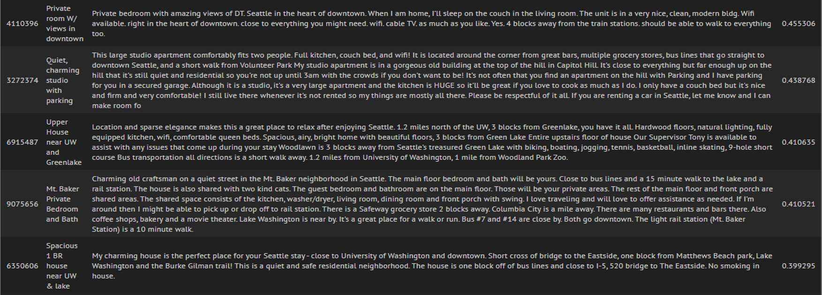
Doc2Vec (PV-DM)
Cosine Similarity Values
Listing_id used as unique doc_id

Slide 26
Doc2Vec
TF-IDF
Cosine Similarity Values

Slide 27
EXPLORATORY DATA ANALYSIS
04
Visualisation of the results
Tensorboard
Google Maps
Calplot
Word Cloud
Boxplot

Slide 28
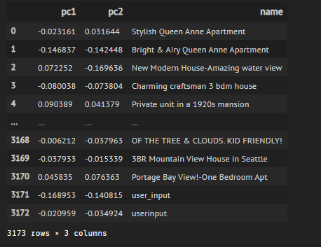
PCA
Principal Component Analysis (Unsupervised)
Dimensionality Reduction Process
Thousands of features/dimensions
2d (pc1, pc2)

Slide 29
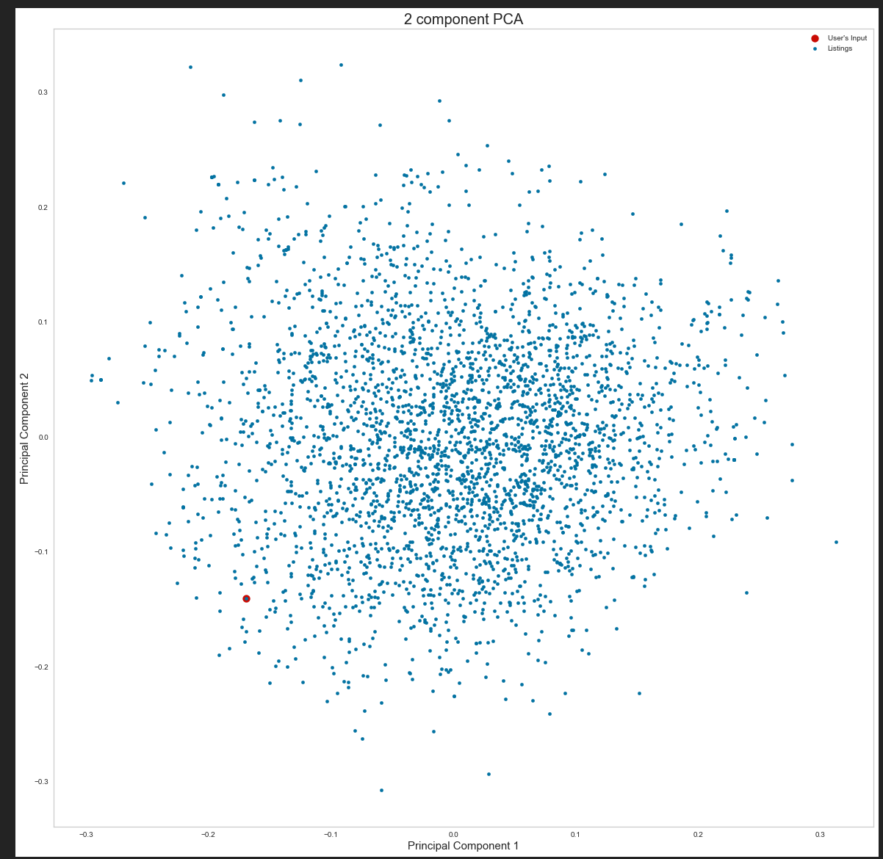
PCA
Scatter Plot of Listings with User’s input
Notes:
Reduces dimensions to 2d/3d

Slide 30
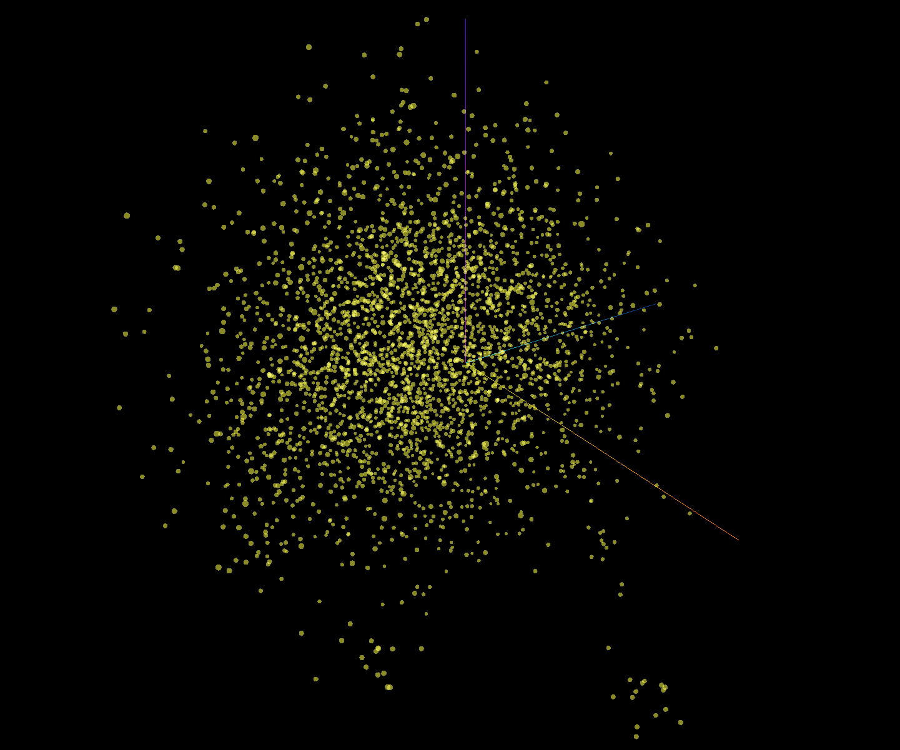
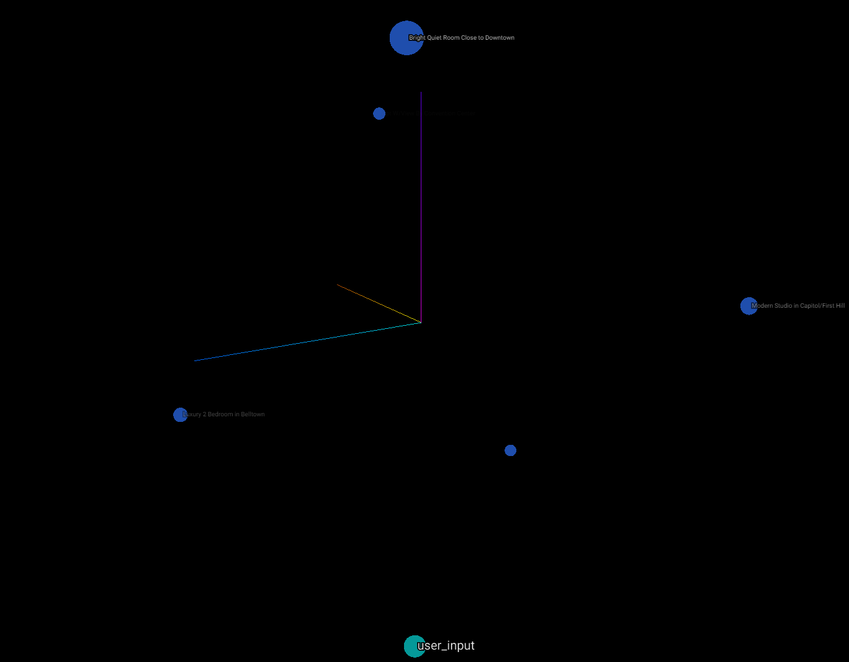
TENSORBOARD EMBEDDING PROJECTOR
Interactive 3D Visualisation Tool
After isolating points
Notes:
Done the dimension reduction for us

Slide 31
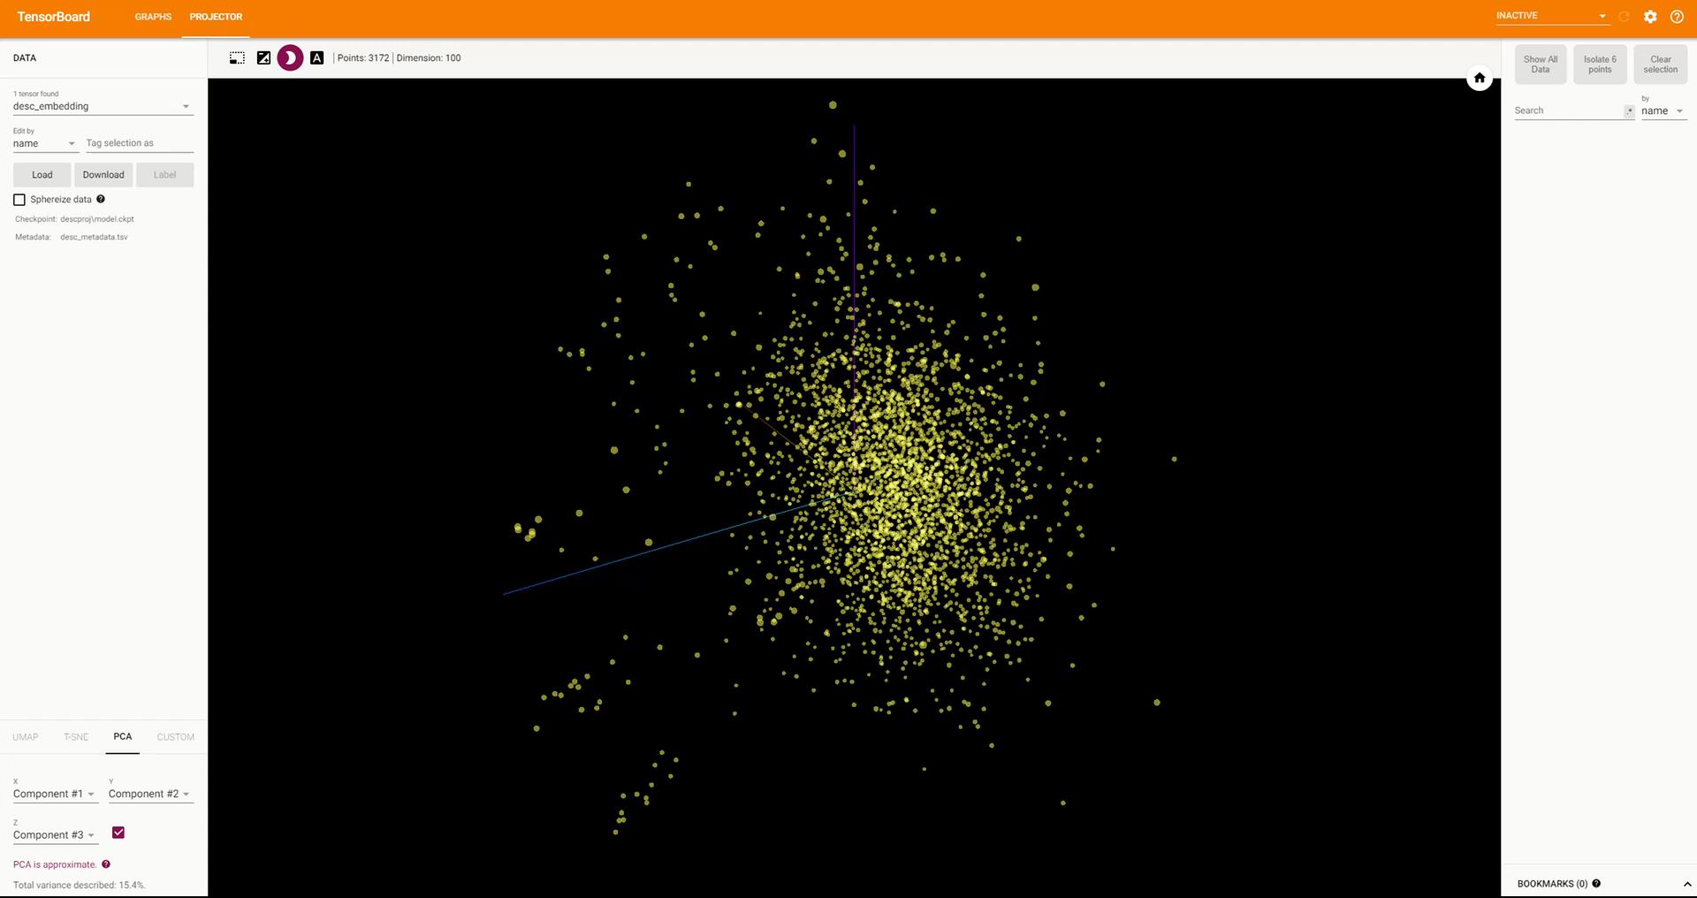

Slide 32
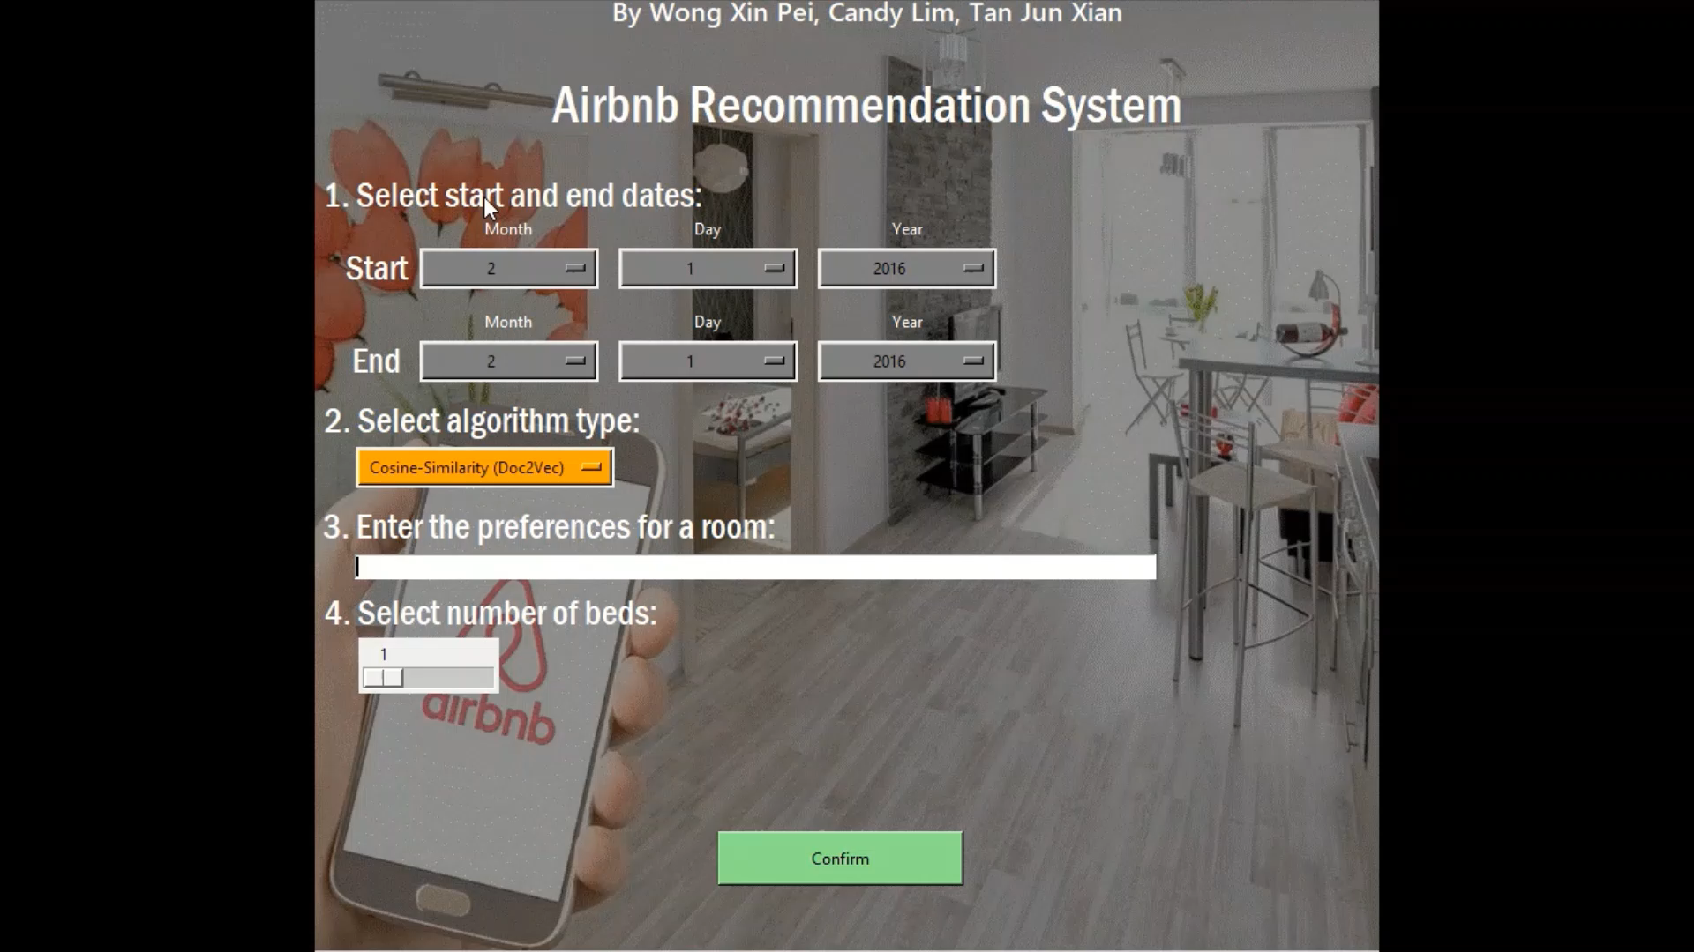
GUI DEMO

Slide 33
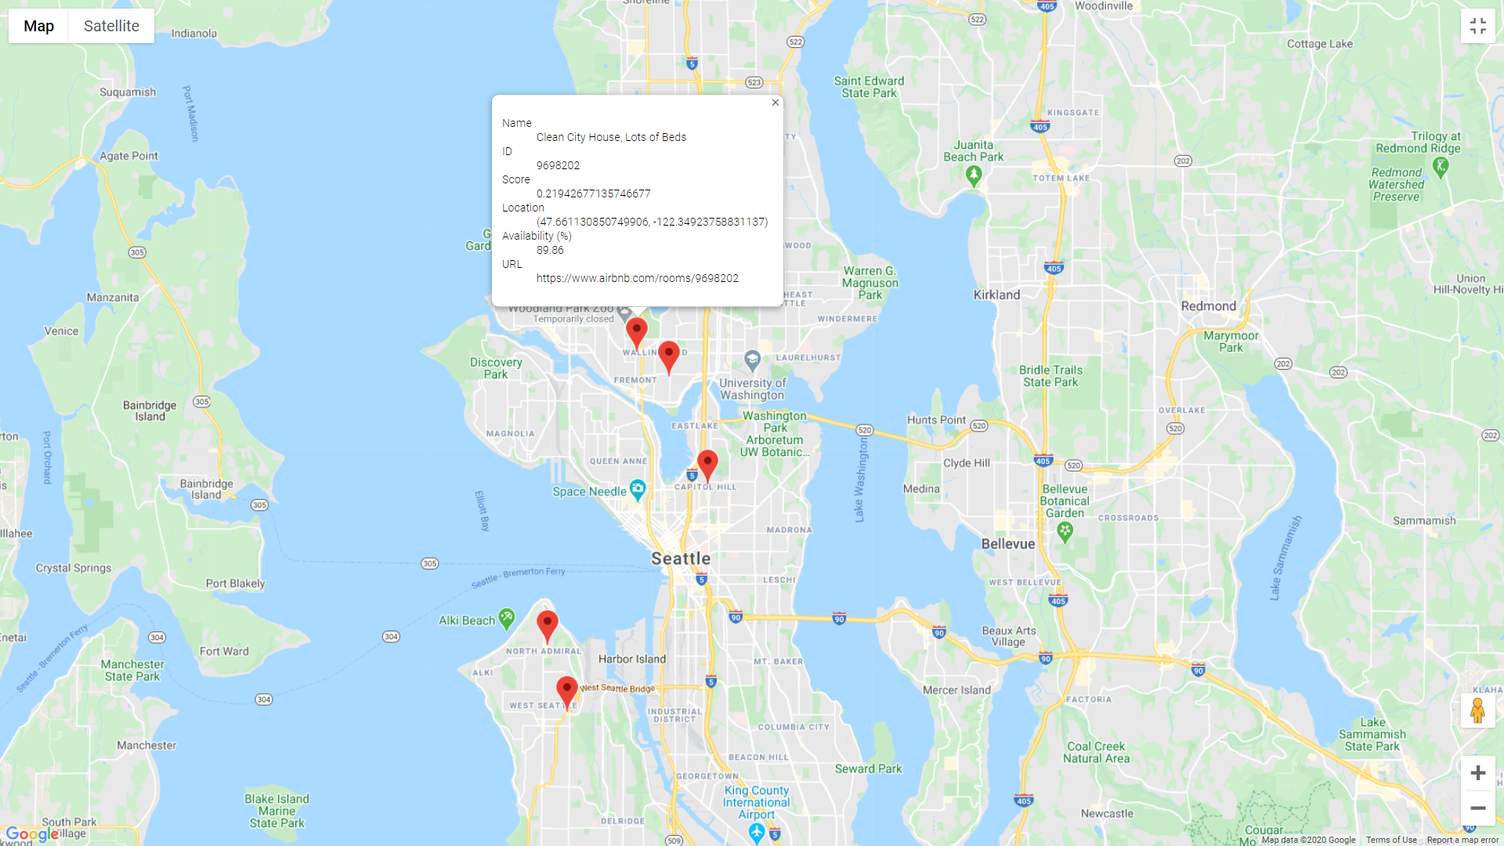
GOOGLE MAPS
Map location of listings on Google Maps

Slide 34
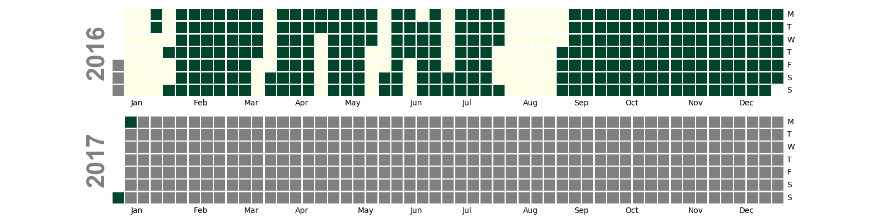
CALPLOT
View the availability dates of each listing
Alternative to Time-Series plot
Days of the week
Green means available
Grey means not in calendar scope

Slide 35


WORD CLOUD
Before removing stopwords
After removing stopwords

Slide 36
BOXPLOT

Slide 37
CONCLUSION
05
Objectives met?
Key lessons learnt
Problem Faced
Further improvements
Members Contribution

Slide 38
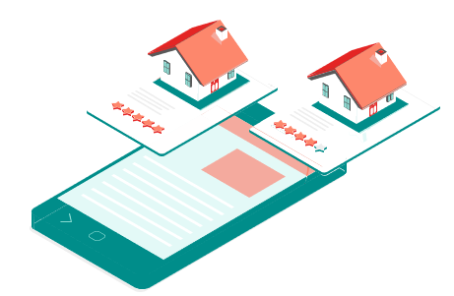
OBJECTIVES MET
Able to recommend user with an Airbnb room with accuracy

Slide 39
OBJECTIVES MET
Notes:
https://towardsdatascience.com/machine-learning-text-processing-1d5a2d638958

Slide 40
KEY LESSONS LEARNT
Text Analytics
API
GUI
Cleansing
Saturn
Neptune
TF-IDF, Doc2Vec, Cosine-Similarity, KNN, PCA
Google Maps API
Textblob API
Combine all the Jupyter notebooks that we had done into one workable application
It’s the biggest planet in the Solar System
Saturn is composed of hydrogen and helium
Neptune is the farthest planet from the Sun

Slide 41
PROBLEMS FACED
Steep learning curve
Features cannot appear on GUI
Not being able to find the right tools
No knowledge on text analytics
Understanding advanced mathematical concepts behind models
Cannot insert HTML inside the GUI, must open another window outside of application
Find suitable tools for given dataset

Slide 42
FURTHER IMPROVEMENTS
-Xin Pei
— Candy
- Jun Xian
What do you think
Can explore on Deep Learning techniques for Text Classification like LTSM, GRU,
Explore BERT/ELMo
UMAP/T-SNE
Notes:
Can use multi-variate models – instead of just filtering, can also use as a predictors.
Response is listingsid

Slide 43
MEMBERS CONTRIBUTION
 | Xin Pei | Candy | Jun Xian
Data Preparation | Here you can describe your items for the quarter | Here you can describe your items for the quarter | Here you can describe your items for the quarter
DS/ML Tools | Here you can describe your items for the quarter | Here you can describe your items for the quarter | Here you can describe your items for the quarter
Exploratory Data Analysis | Here you can describe your items for the quarter | Here you can describe your items for the quarter | Here you can describe your items for the quarter
Slides | Here you can describe your items for the quarter | Here you can describe your items for the quarter | Here you can describe your items for the quarter
Notes:
Can use multi-variate models – instead of just filtering, can also use as a predictors.
Response is listingsid

Slide 44
THANK YOU

